Slide 1

Stock Trading System
By Amit Jadhav & Yash Pasar

Slide 2
Problem Statement
A trader needs to check the status of different trading accounts by logging on to their respective databases as well as provide the Administrator with meaningful insights from this database

Slide 3

Solution
Design a database that consolidates all the trading accounts of a single user in a unified platform

Slide 4

How did we do it??
Tools Used: Visio, SQL Server, MS Access

Slide 5
Step 1: Start with identifying your actors/entities

Slide 6
Step 2: Construct an ERD and establish relationship

Slide 7
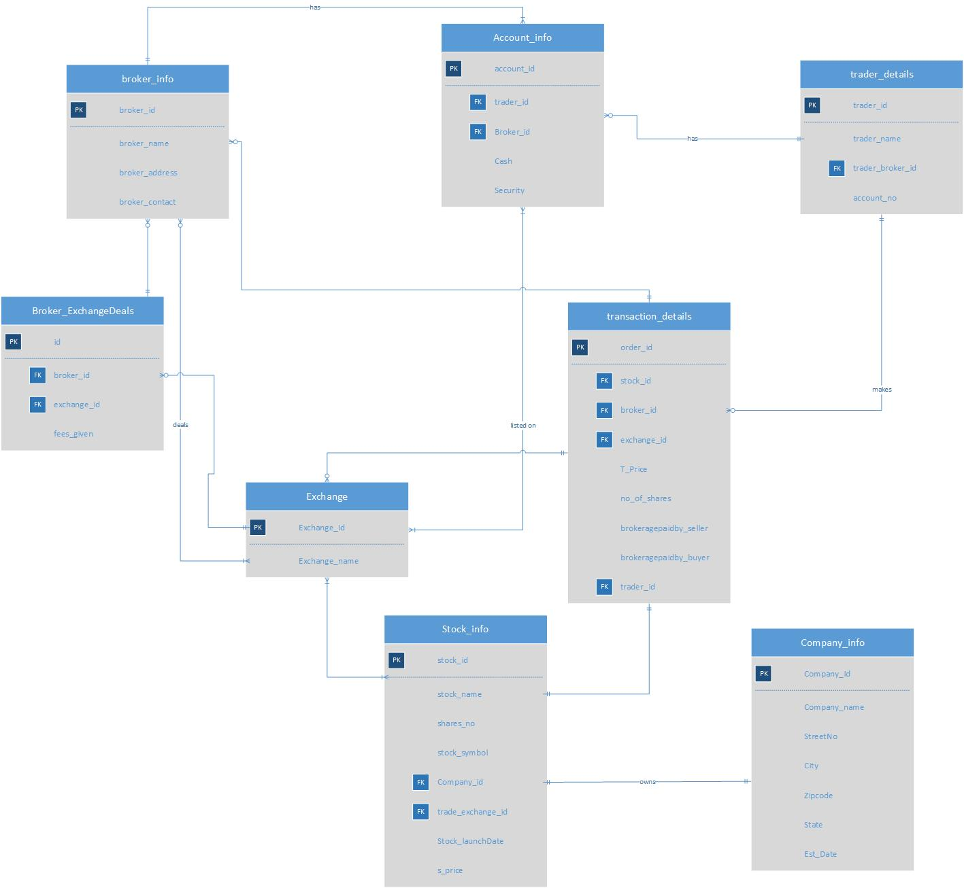

Slide 8
Step 3: construct tables and populate them in SQL

Slide 9
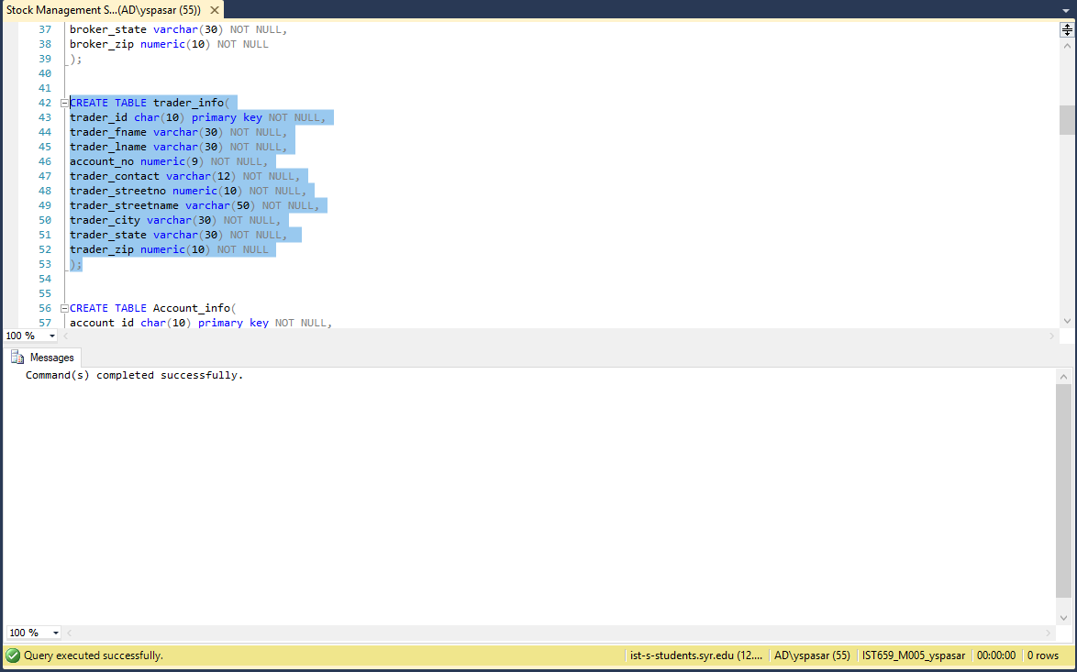

Slide 10
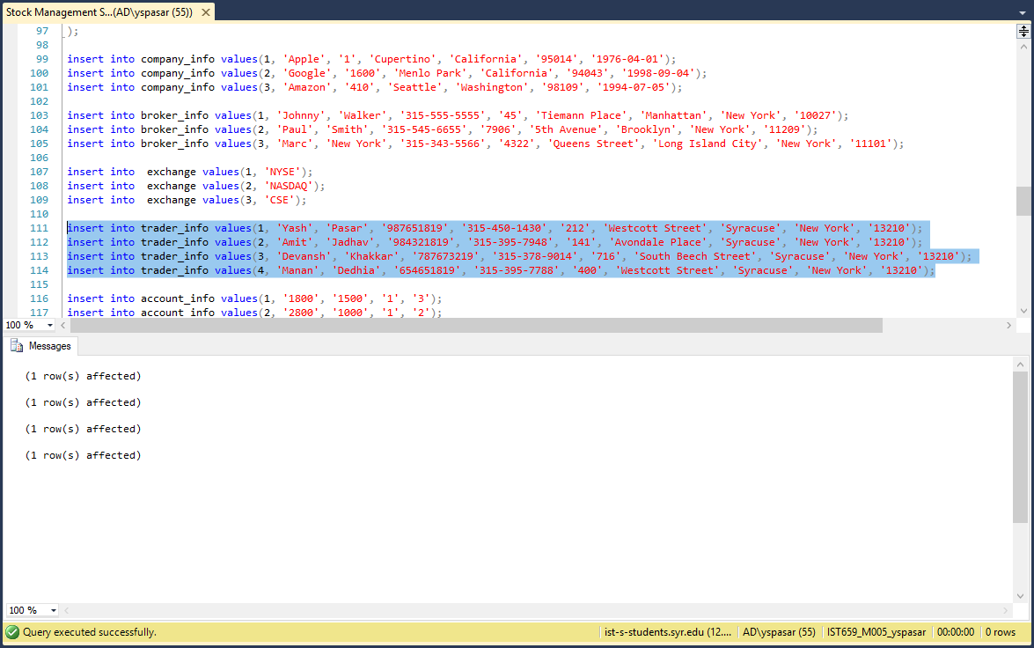

Slide 11
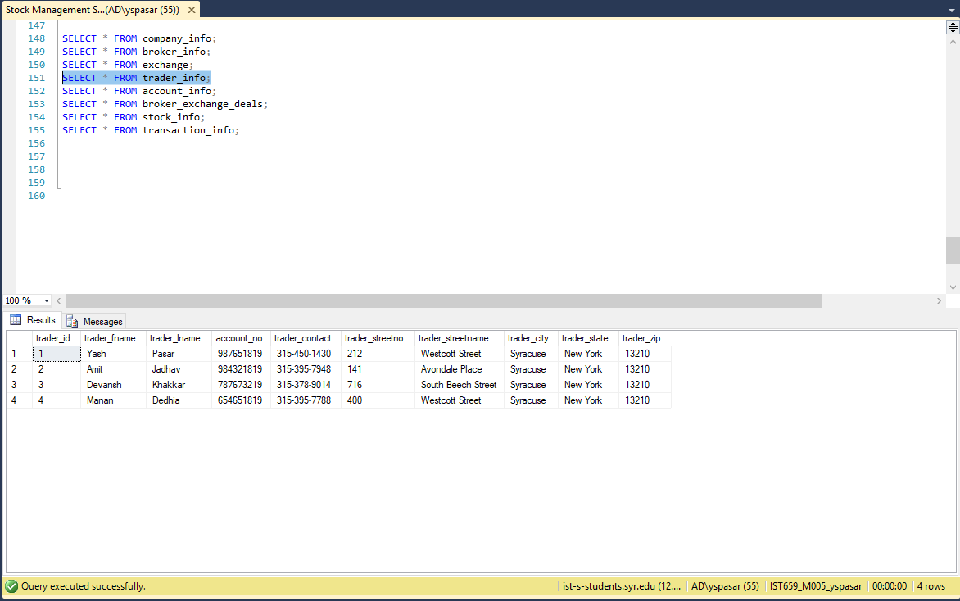

Slide 12

You are all set to run your queries now

Slide 13
Step 4: Create Navigation interface

Slide 14
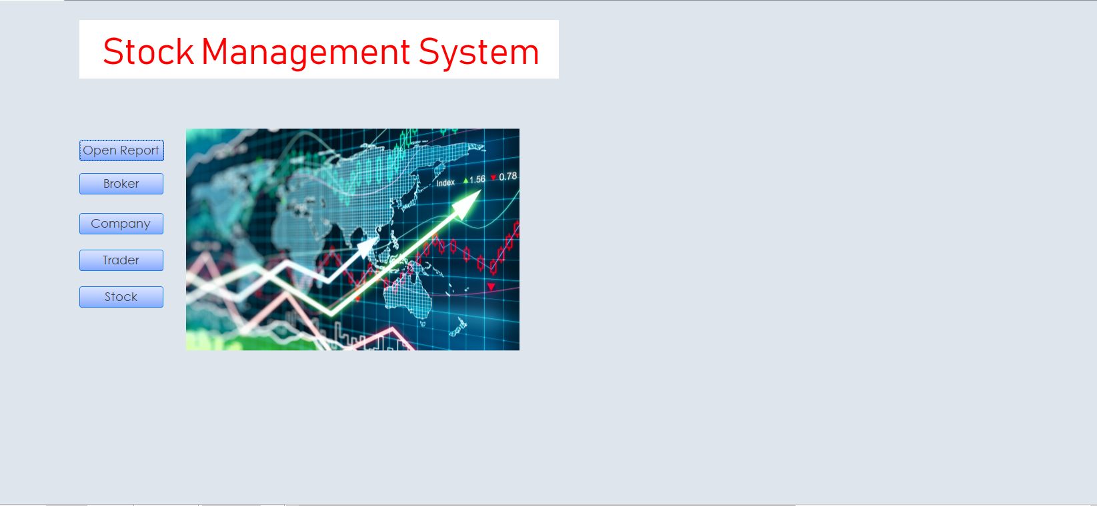

Slide 15
Step 5: Add Forms to the interface as tabs

Slide 16
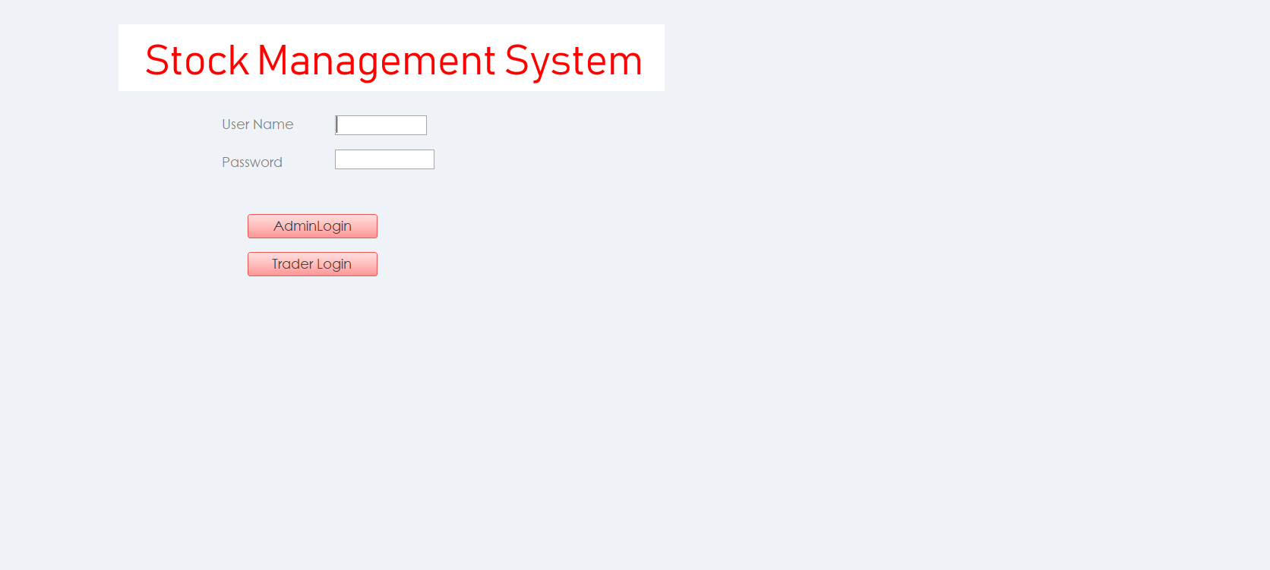

Slide 17
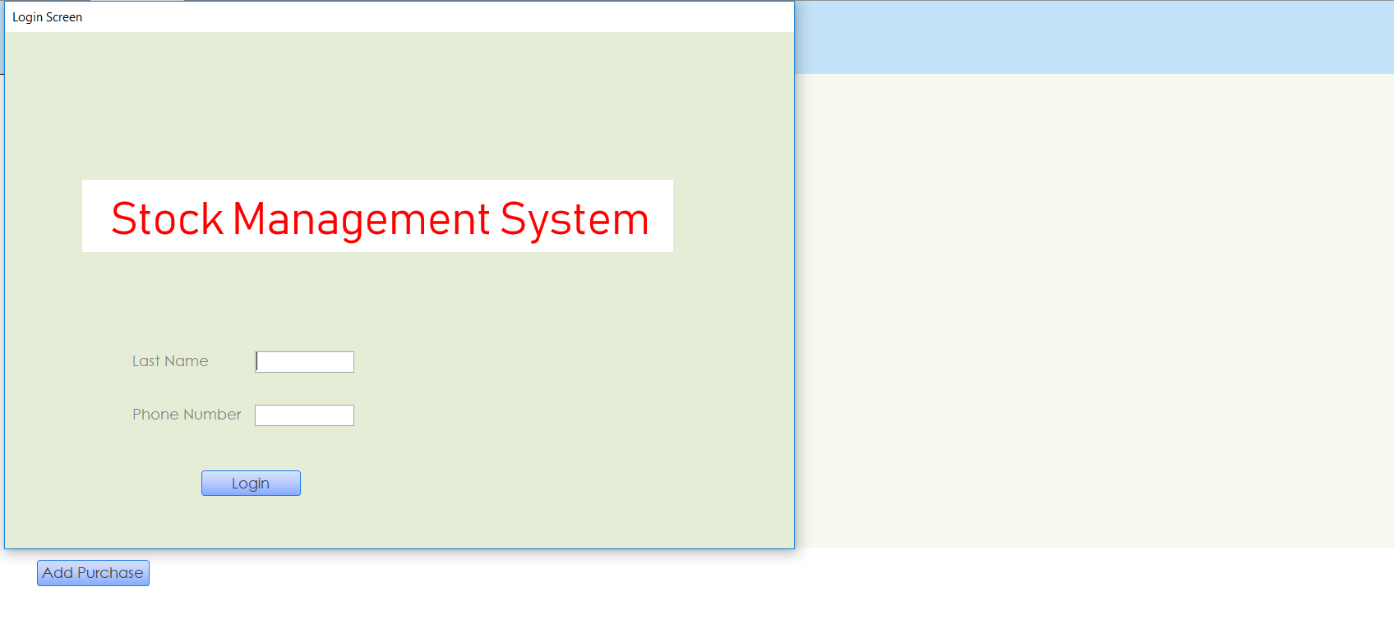

Slide 18
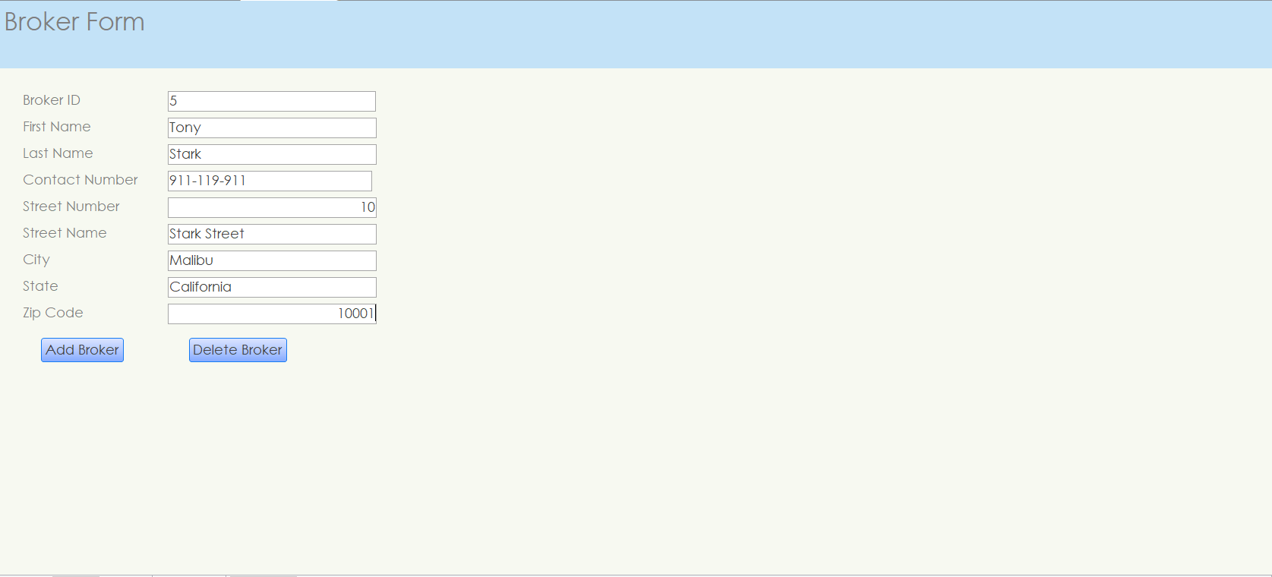

Slide 19
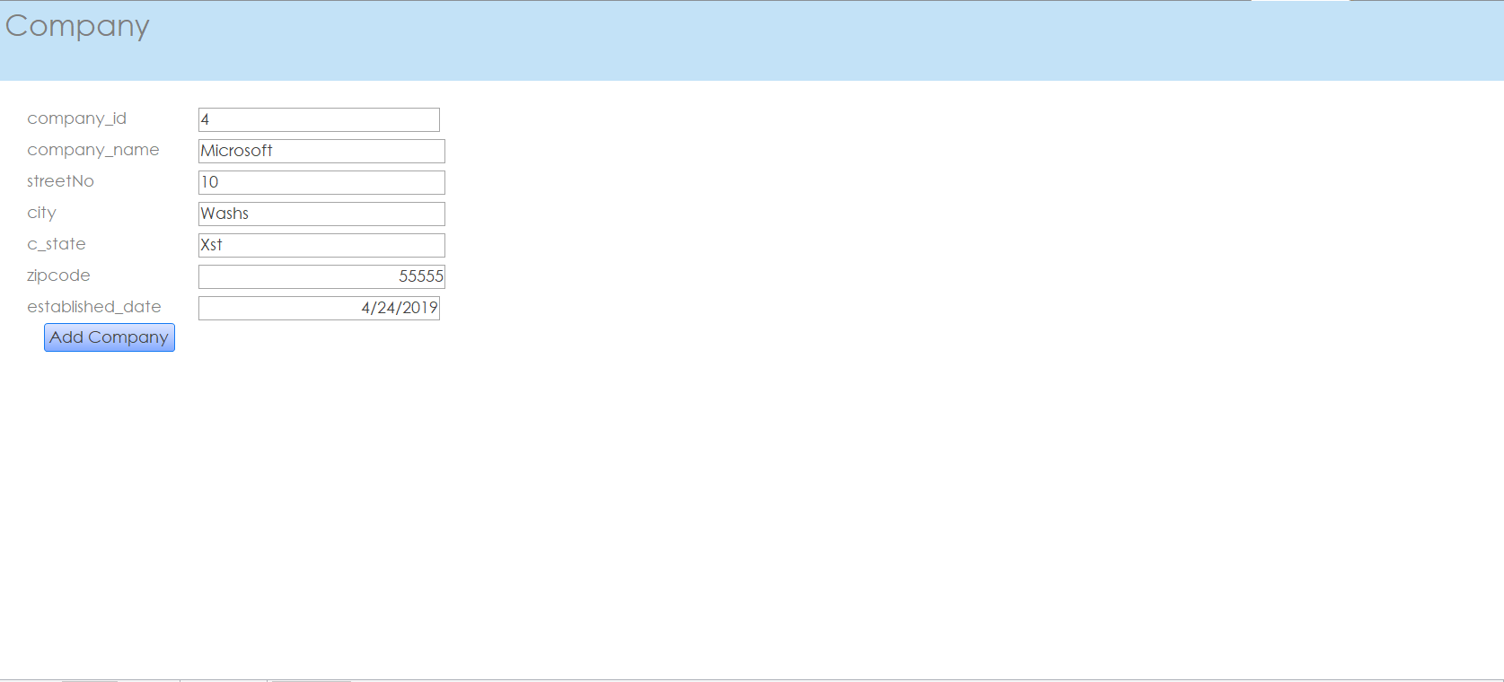

Slide 20
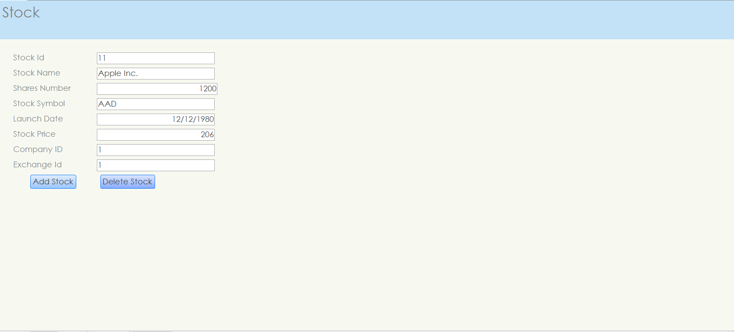

Slide 21
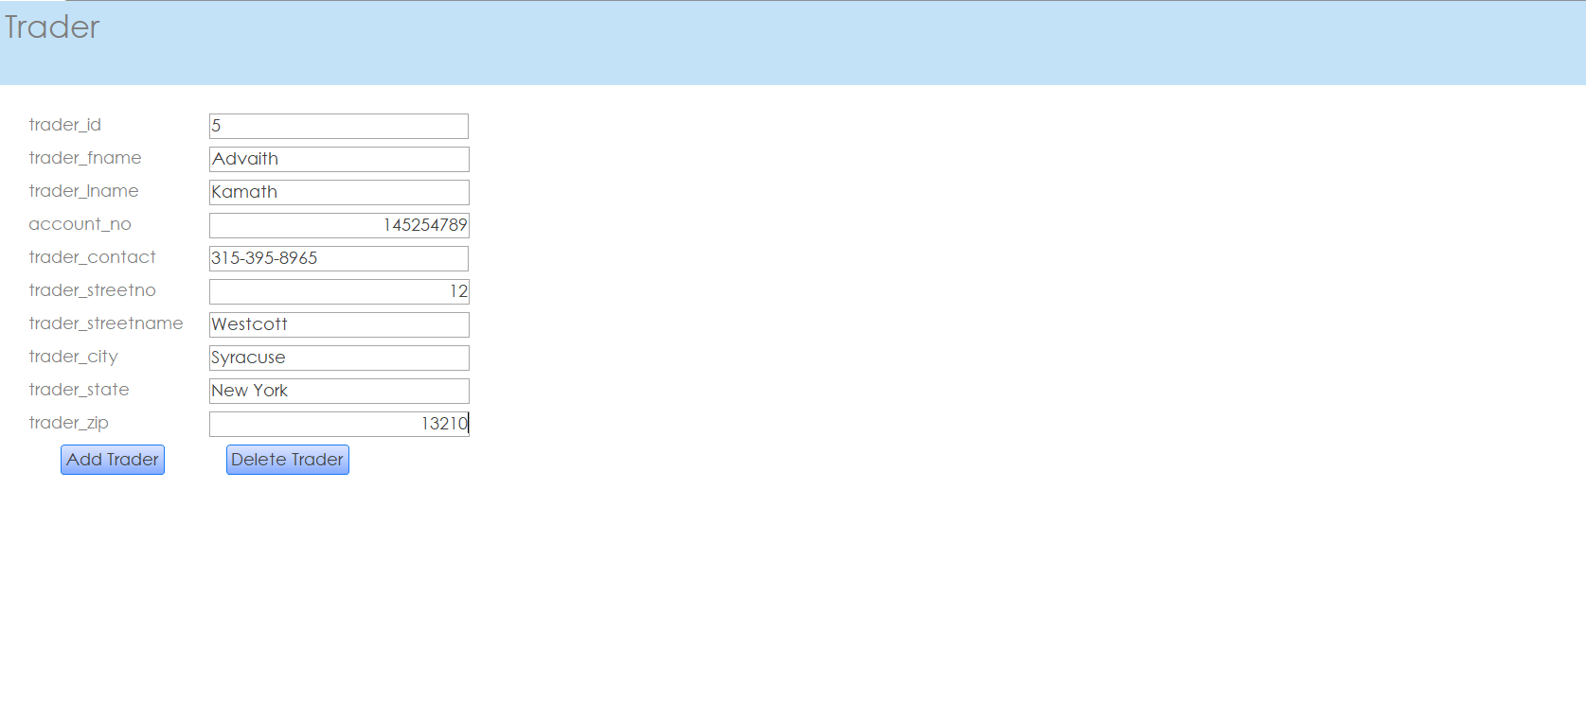

Slide 22
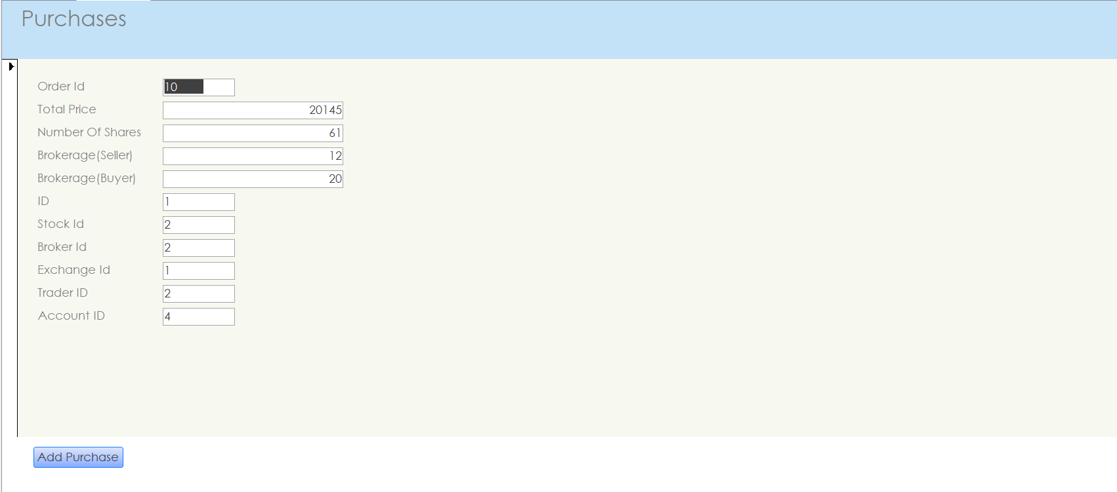

Slide 23
Step 6: Trigger

Slide 24
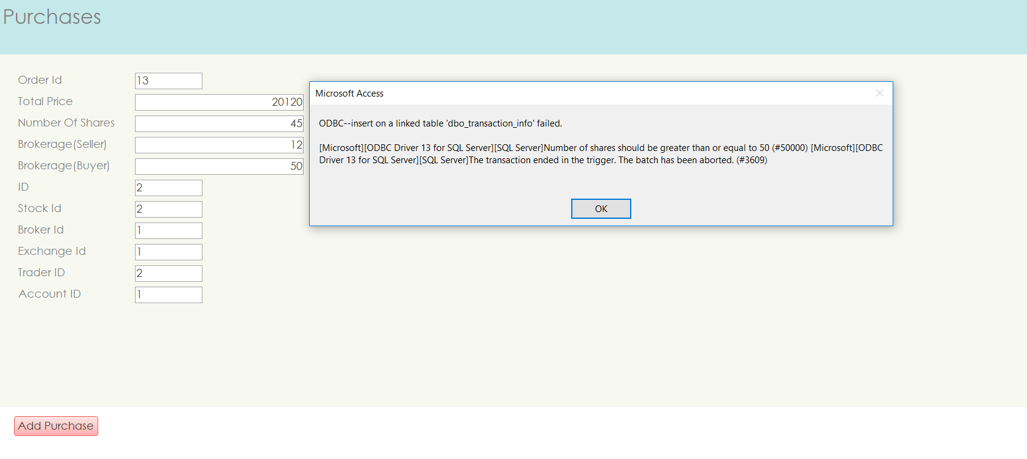

Slide 25
Step 7: Create Reports

Slide 26
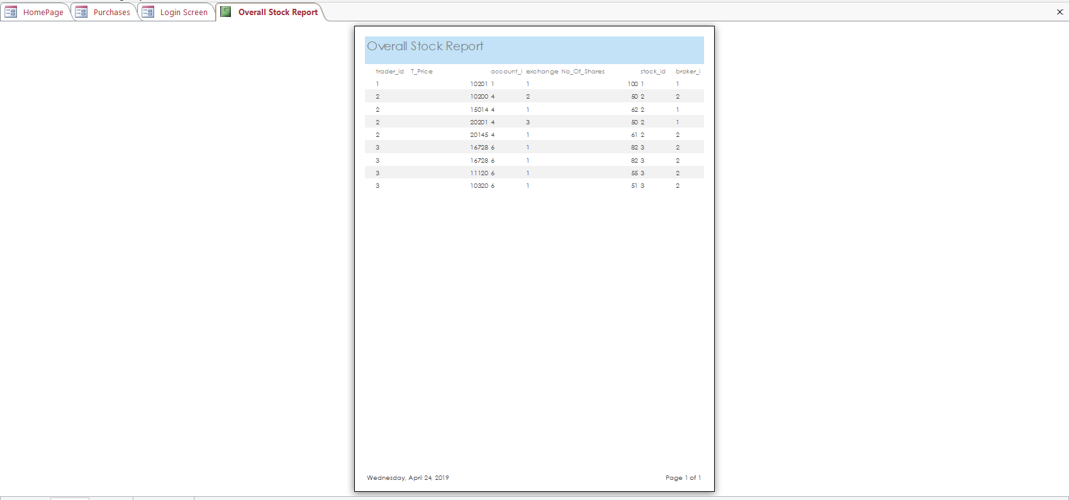

Slide 27


Slide 28
Thank You

